Slide 1
PREDICTING AMES HOUSING SALE PRICE

Slide 2
OVERVIEW OF DATASET
2006- 2010 Housing Dataset from Ames Assessor's Office
Over 2000 transactions
82 Features
Notes:
https://www.act.org/content/dam/act/unsecured/documents/cccr2017/CCCR_National_2017.pdf
https://reports.collegeboard.org/archive/sat-suite-program-results/2017/overview#:~:text=The%20class%20of%202017%20is,takers%20took%20the%20new%20SAT.)

Slide 3
PROBLEM STATEMENT
Role: Analyst for real estate company
Problem statement: What are the features of a property that our clients should look out for in order to sell their houses at a higher price in Ames?
Audience: Sellers and Buyers looking to resale

Slide 4
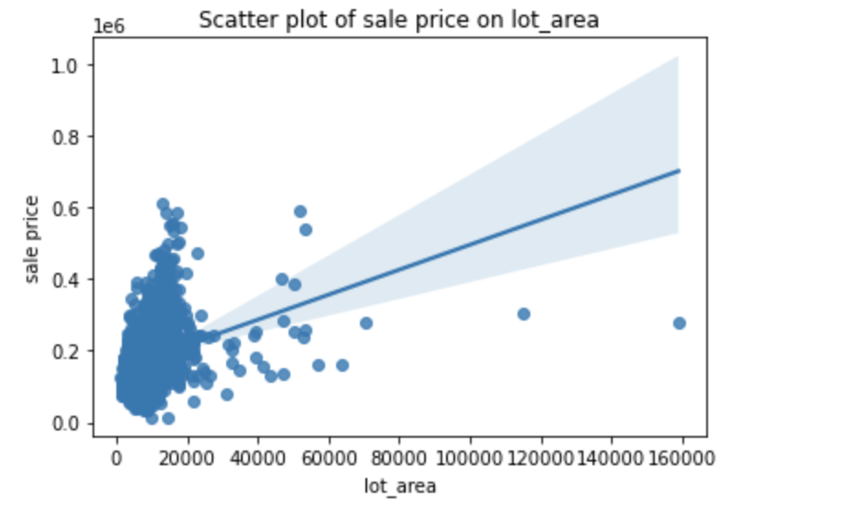
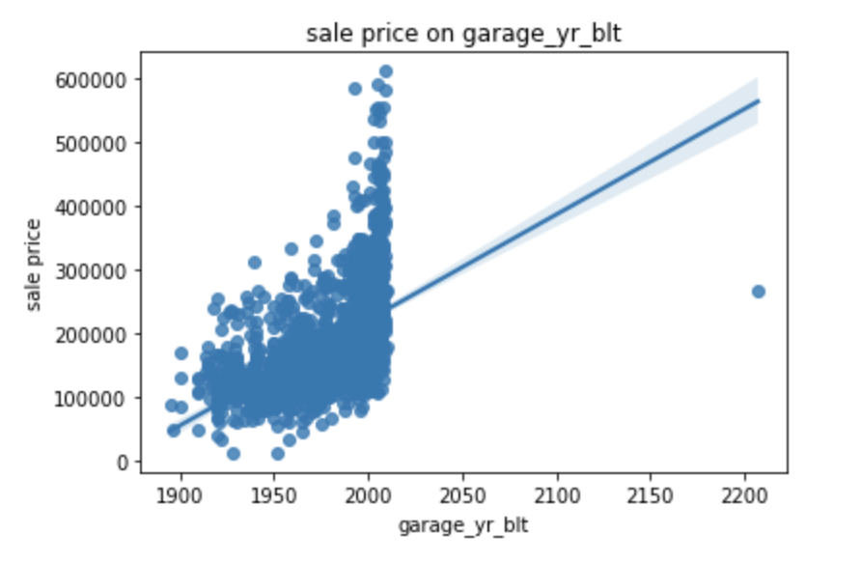
DATA CLEANING
Typo!

Slide 5
DATA CLEANING
Drop
Compare
Add
Conversion
1-2 nan
Over 75%
Check for existence (e.g. Fireplace Quality and Fireplace Area)
New columns (e.g. Age sold/ Remod)
Categorical Data into Integer
One hot encoding for Nominal Data

Slide 6
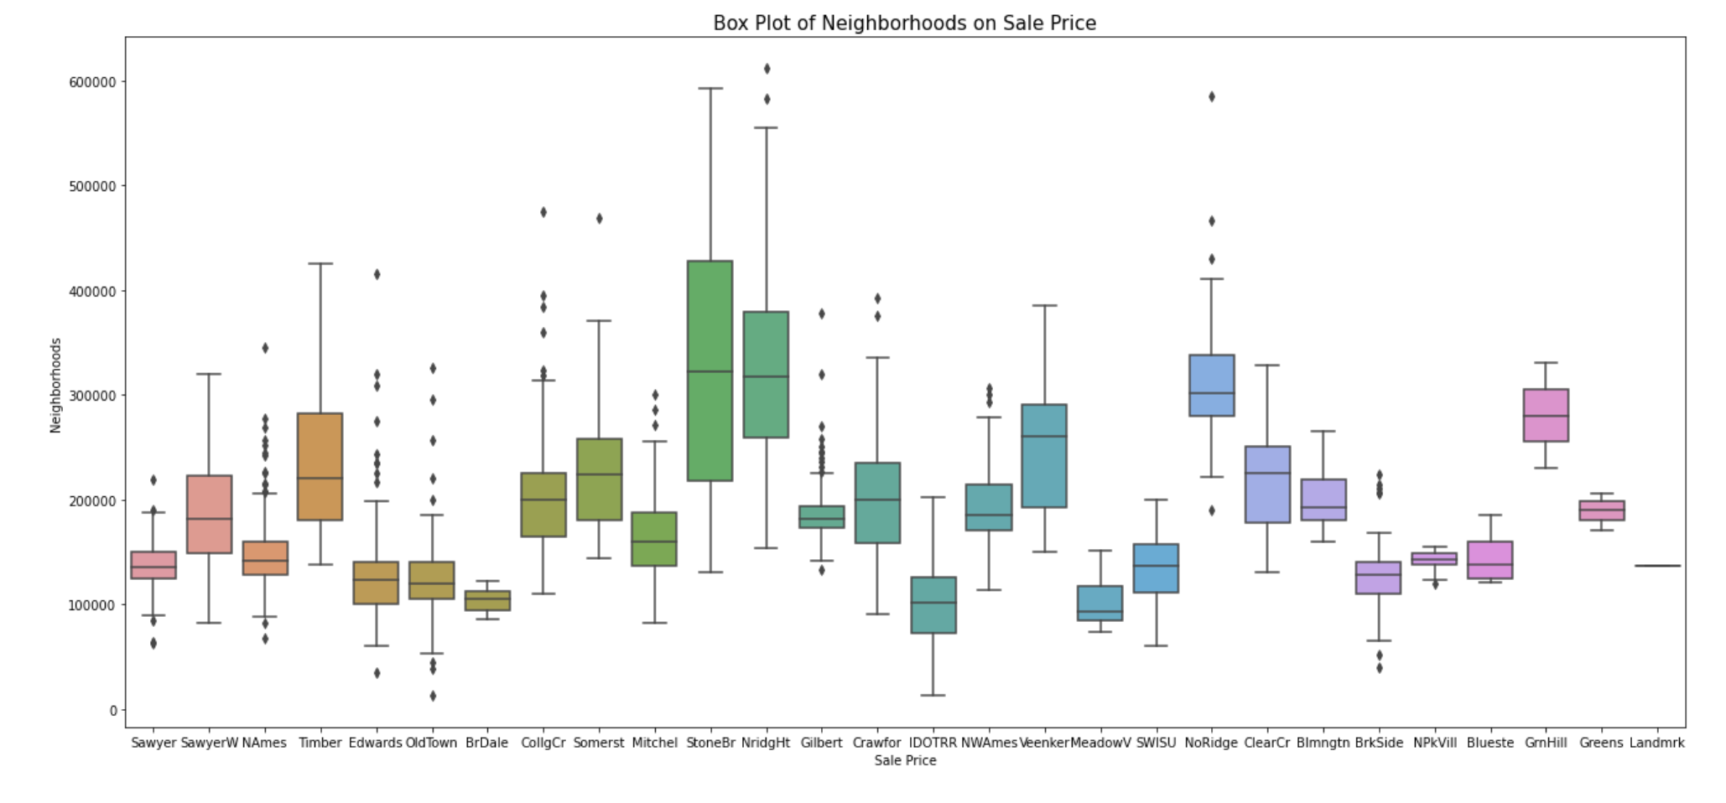
EXPLORATORY DATA ANALYSIS - BOXPLOT
Wealthier Neighborhoods: Stone Brook and Northridge Heights

Slide 7
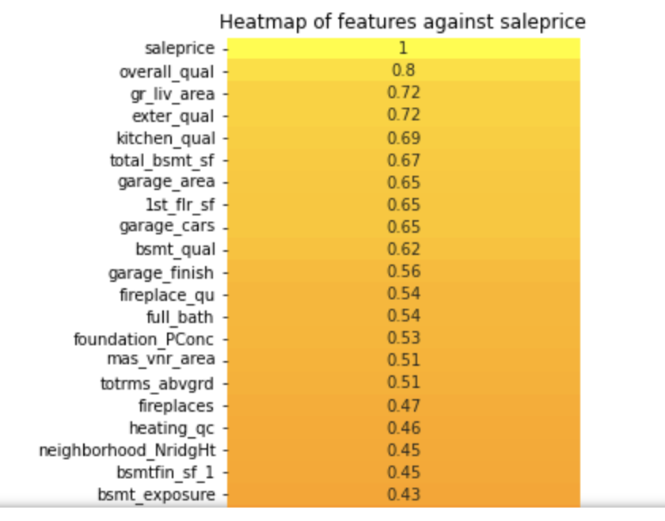
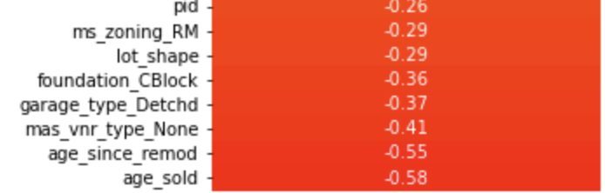
Filtering Data
+ Correlation
- Correlation

Slide 8
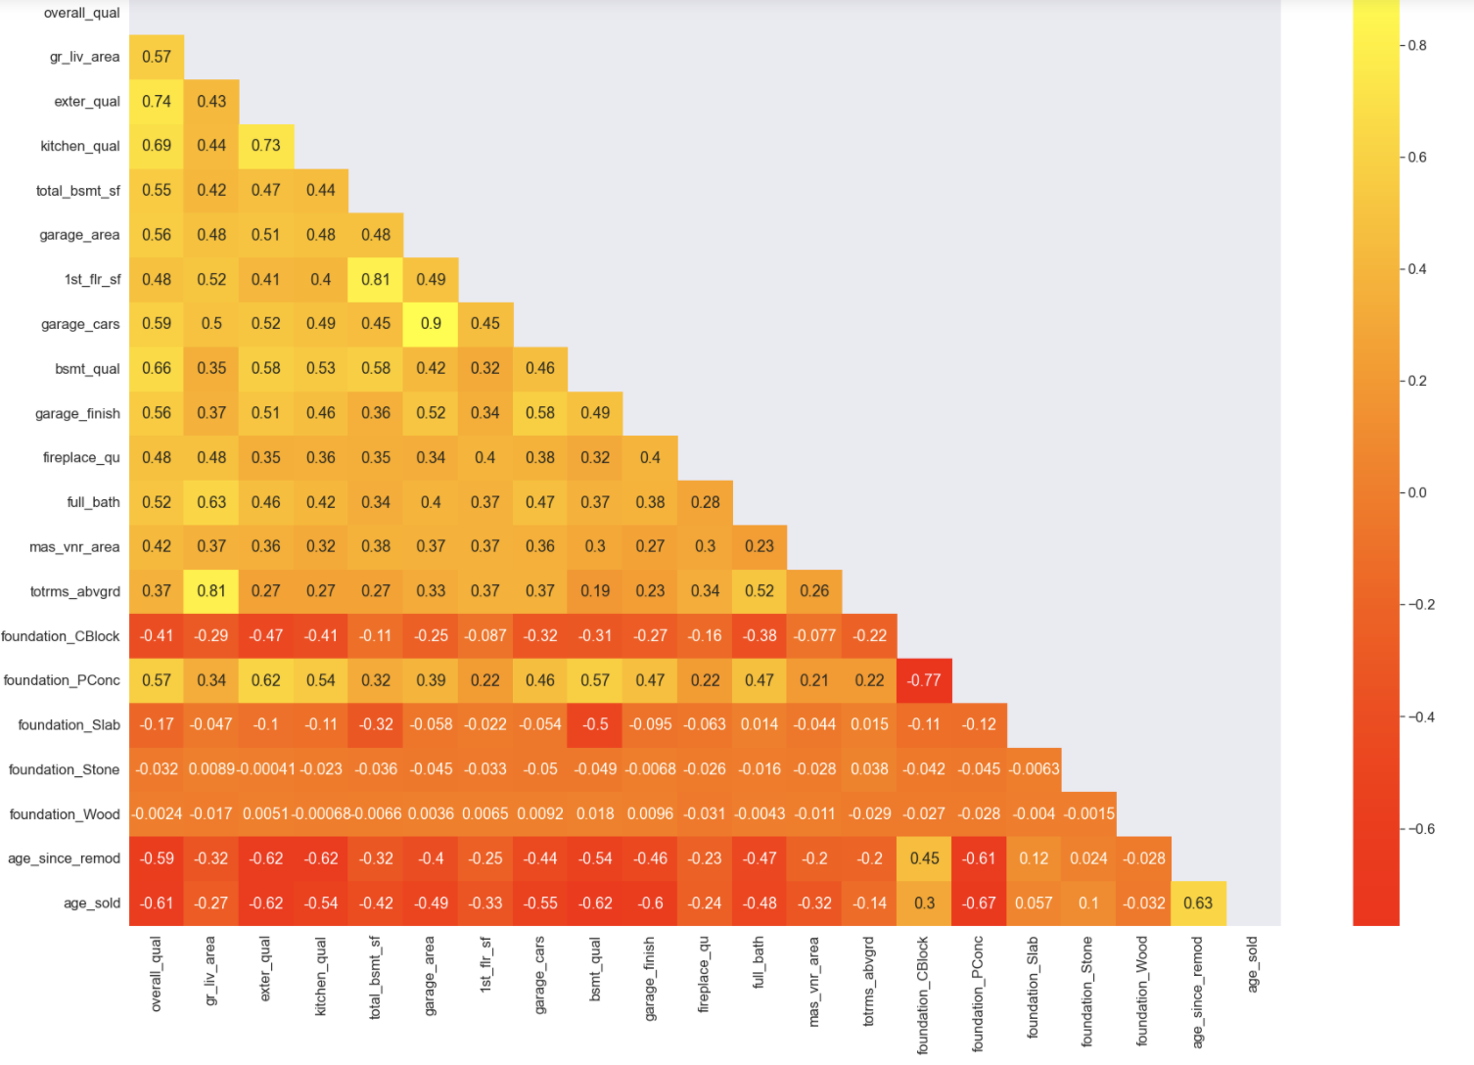
Check to see if we can drop! E.g. Garage Cars/Area

Slide 9
EXPLORATORY MODELS | LINEAR MODEL | CV RMSE | HOLDOUT RMSE | AVERAGE
EDA and Research (E.g. Age, Location, Condition) | Linear | 3.19 * 10 ⁻¹⁶ | 30,404 | 30,532
 | Lasso | 29,268 | 30,609
 | Ridge | 29,257 | 30,509
 | Elastic net | 29,268 | 30,609
Heatmap High Correlation | Linear | 28,814 | 32,836 | 32,840
 | Lasso | 28,827 | 32,836
 | Ridge | 28,815 | 32,852
 | Elastic net | 28,827 | 32,836
Polynomial | Linear | 1.7 * 10 ¹⁶ | 25,795 | 23,437
 | Lasso | 23,361 | 22,763
 | Ridge | 23,207 | 22,428
 | Elastic net | 23,361 | 22,763

Slide 10
FINAL MODEL SELECTION
Drop complicated features
Masonry veneer area
Basement square feet Type 1
 | LINEAR MODEL | CV RMSE | HOLDOUT RMSE | KAGGLE
FINAL MODEL | Linear | 6.1 * 10 ¹⁵ | 25,206 | PRIVATE: 21,807 PUBLIC: 23,452
 | Lasso | 22,694 | 23,909
 | Ridge (Optimal Alpha: 28.66) | 22,298 | 23,715
 | Enet | 22,694 | 23,909
BASELINE |  |  |  | 79,019

Slide 11
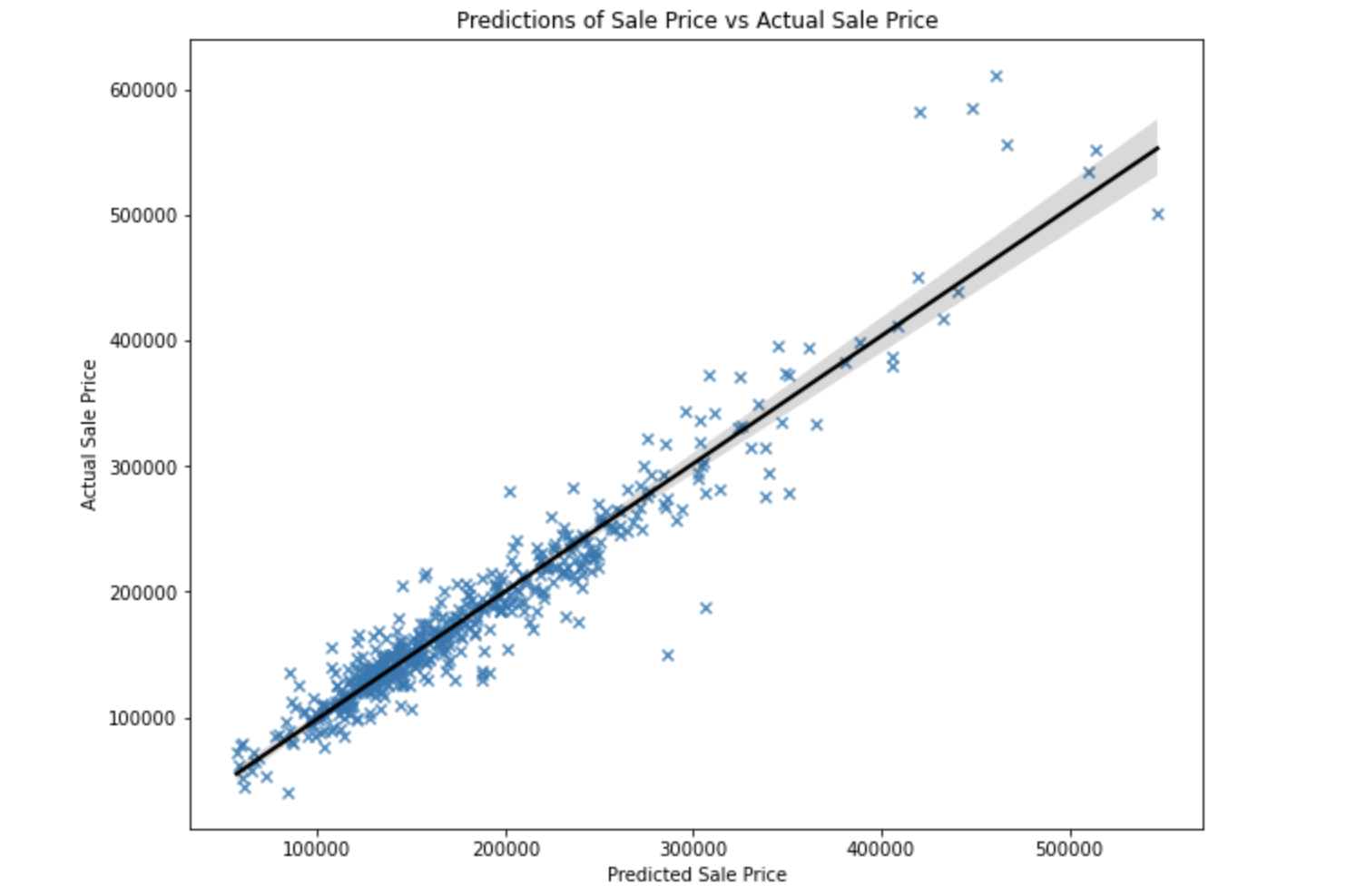

Slide 12
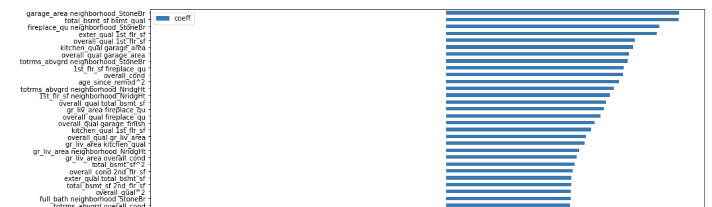
BAR PLOT OF COEFFICIENTS
Multiplier effect from interaction terms!

Slide 13
LESSONS
Analyze features for possible interaction terms
Interaction terms have multiplier effect on prediction.
Models with penalization perform better than a simple linear regression
Transform coefficients to zero or smaller figures
One model may not be sufficient to predict all data points
Introduce a second model for high value houses

Slide 14
CONCLUSION & RECOMMENDATIONS
Top 5 Features | Relationship | Recommendations
Size | + | Finish up any unfinished works e.g. Basement
Quality | + | Refurbished with best equipment and materials
Neighborhood | + | Sellers in wealthier neighborhoods can price their house higher
Condition | + | Repair any damages
Age | - | Remodel/Upgrade

Slide 15
FURTHER RESEARCH
Collect local data as some data might be irrelevant (e.g. Garage)
Economic Variables
Distance from amenities (e.g. school, hospitals)
Logistic Regression
Latest Data

Slide 16
SOURCES
https://www.cityofames.org/government/departments-divisions-i-z/public-works/alley-maintenance
https://www.census.gov/construction/chars/
https://statisticalatlas.com/neighborhood/Iowa/Ames/Stone-Brooke/Household-Income
https://www.weichert.com/search/community/neighborhood.aspx?hood=60290
https://www.99.co/singapore/insider/factors-affecting-resale-value/
https://www.thebalance.com/pricing-houses-to-sell-1798968
https://www.compmort.com/home-location-and-property-value/
https://www.investopedia.com/articles/mortages-real-estate/11/factors-affecting-real-estate-market.asp

